Slide 1
Discrete Mathematics recurrence relation
Liangfeng Zhang
School of Information Science and Technology
ShanghaiTech University

Slide 2
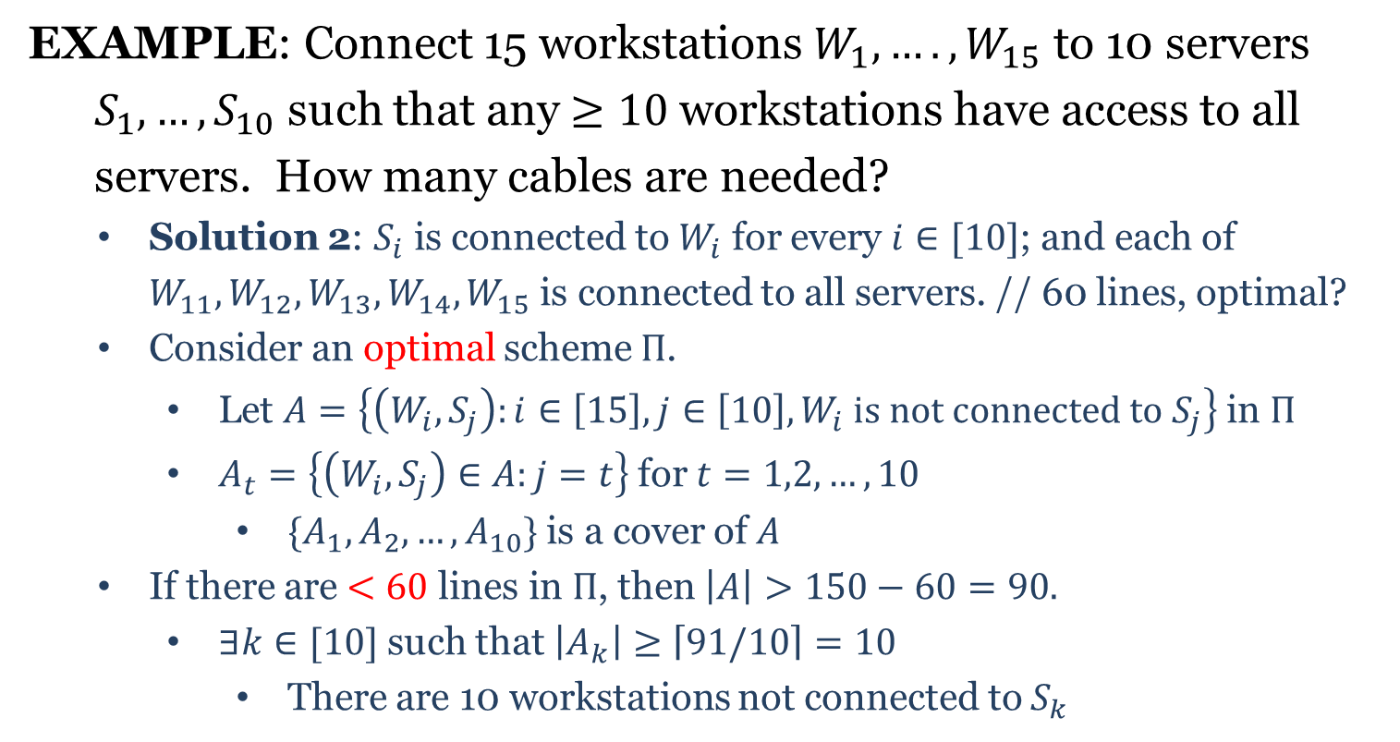
Pigeonhole Principle
EXAMPLE: Connect 15 workstations $W_{1},….,W_{15}$ to 10 servers
$S_{1},…,S_{10}$ such that any $≥10$workstations have access to all
servers. How many cables are needed?
Solution 2: $S_{i}$ is connected to $W_{i}$ for every $i∈[10]$; and each of $W_{11},W_{12},W_{13}, W_{14}, W_{15}$ is connected to all servers. // 60 lines, optimal?
Consider an optimal scheme $Π$.
Let $A=\left\{\left(W_{i},S_{j}\right):i∈\left[15\right], j∈\left[10\right], W_{i} is not connected to S_{j}\right\}$ in $Π$
$A_{t}=\left\{\left(W_{i},S_{j}\right)∈A:j=t\right\}$ for $t=1,2,…,10$
$\{A_{1},A_{2},…,A_{10}\}$ is a cover of $A$
If there are $<60$ lines in $Π$, then $\left|A\right|>150−60=90.$
$∃k∈[10]$ such that $\left|A_{k}\right|≥\left\lceil 91/10\right\rceil =10$
There are 10 workstations not connected to $S_{k}$

Slide 3
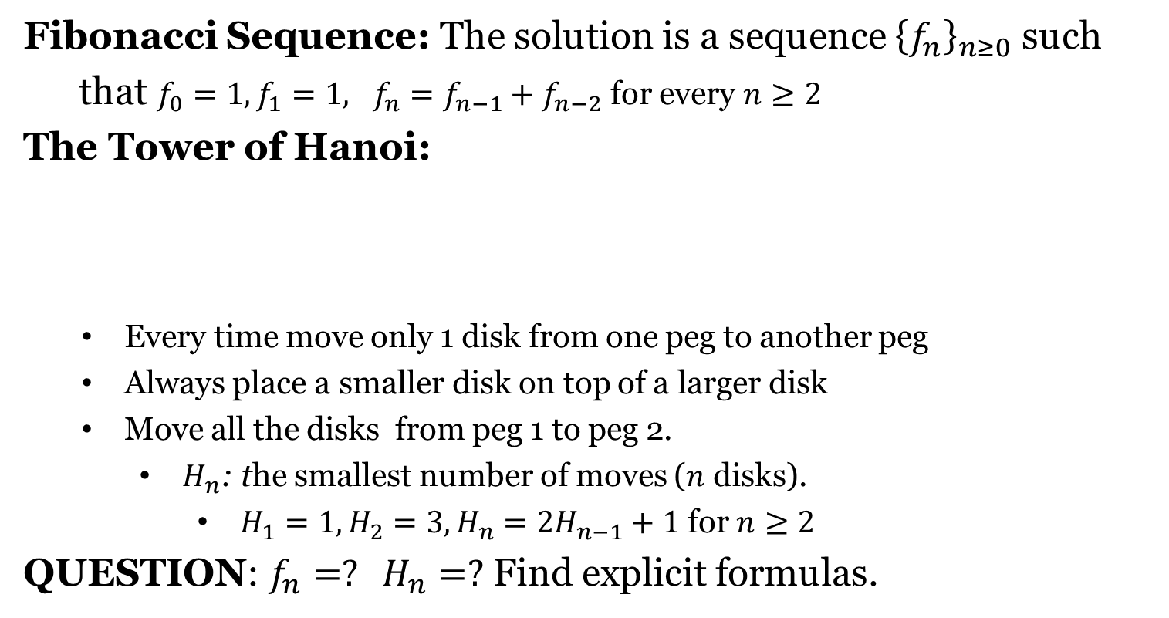
Recurrence Relation (RR)
Fibonacci Sequence: The solution is a sequence ${\left\{f_{n}\right\}}_{n≥0}$ such
that $f_{0}=1, f_{1}=1, f_{n}=f_{n−1}+f_{n−2}$ for every $n≥2$
The Tower of Hanoi:
Every time move only 1 disk from one peg to another peg
Always place a smaller disk on top of a larger disk
Move all the disks from peg 1 to peg 2.
$H_{n}$: the smallest number of moves ($n$ disks).
$H_{1}=1, H_{2}=3, H_{n}=2H_{n−1}+1$ for $n≥2$
QUESTION: $f_{n}=? H_{n}=?$ Find explicit formulas.

Slide 4
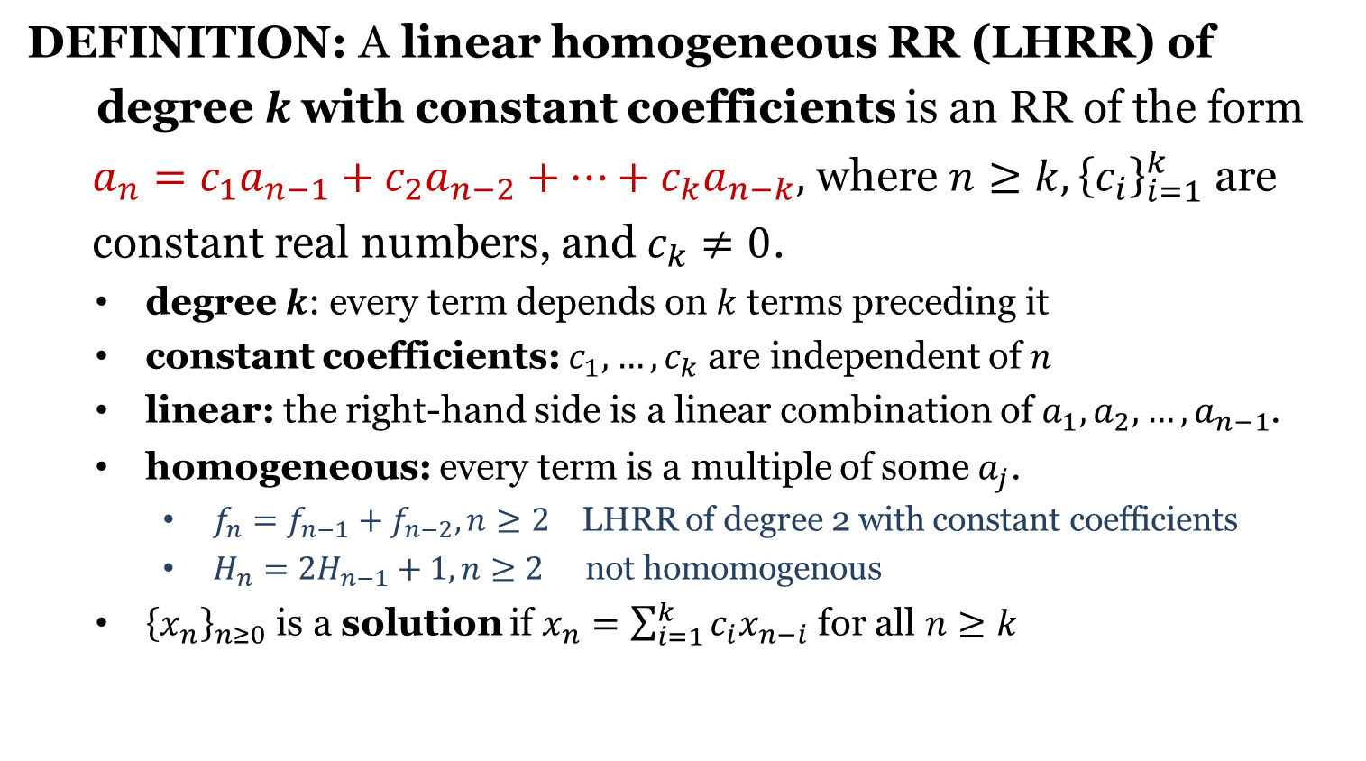
Linear Homogeneous RR
DEFINITION: A linear homogeneous RR (LHRR) of
degree$k$with constant coefficients is an RR of the form
$a_{n}=c_{1}a_{n−1}+c_{2}a_{n−2}+⋯+c_{k}a_{n−k},$ where $n≥k,{\left\{c_{i}\right\}}_{i=1}^{k}$ are
constant real numbers, and $c_{k}≠0$.
degree $k$: every term depends on $k$ terms preceding it
constant coefficients: $c_{1},…,c_{k}$ are independent of $n$
linear: the right-hand side is a linear combination of $a_{1},a_{2},…,a_{n−1}$.
homogeneous: every term is a multiple of some $a_{j}$.
$f_{n}=f_{n−1}+f_{n−2}, n≥2$ LHRR of degree 2 with constant coefficients
$H_{n}=2H_{n−1}+1, n≥2$ not homomogenous
${\left\{x_{n}\right\}}_{n≥0}$ is a solution if $x_{n}=\sum_{i=1}^{k}{c_{i}x_{n−i}}$ for all $n≥k$

Slide 5
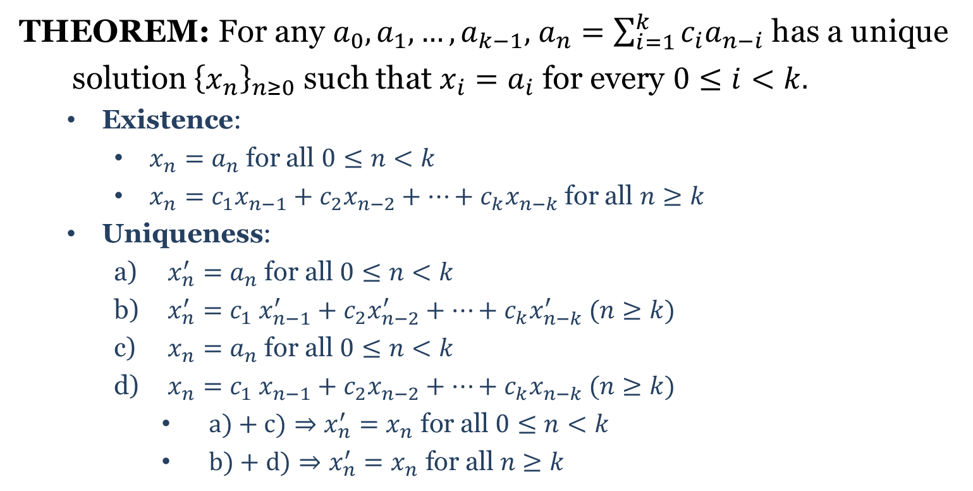
Existence and Uniqueness
THEOREM: For any $a_{0},a_{1},…,a_{k−1},$ $a_{n}=\sum_{i=1}^{k}{c_{i}a_{n−i}}$ has a unique
solution ${\left\{x_{n}\right\}}_{n≥0}$ such that $x_{i}=a_{i}$ for every $0≤i<k.$
Existence:
$x_{n}=a_{n}$ for all $0≤n<k$
$x_{n}=c_{1}x_{n−1}+c_{2}x_{n−2}+⋯+c_{k}x_{n−k}$ for all $n≥k$
Uniqueness:
$x_{n}^{′}=a_{n}$ for all $0≤n<k$
$x_{n}^{′}=c_{1} x_{n−1}^{′}+c_{2}x_{n−2}^{′}+⋯+c_{k}x_{n−k}^{′} (n≥k)$
$x_{n}=a_{n}$ for all $0≤n<k$
$x_{n}=c_{1} x_{n−1}+c_{2}x_{n−2}+⋯+c_{k}x_{n−k} (n≥k)$
$a)+c)⇒x_{n}^{′}=x_{n} \text{for} \text{all} 0≤n<k$
$b)+d)⇒x_{n}^{′}=x_{n} \text{for} \text{all} n≥k$

Slide 6
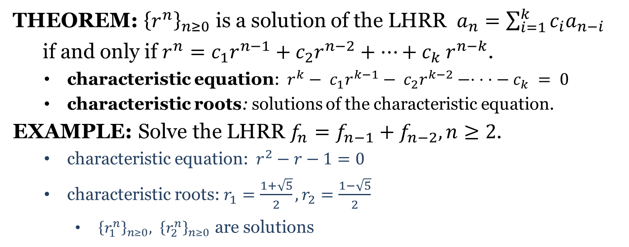
Characteristic Roots
THEOREM: ${\left\{r^{n}\right\}}_{n≥0}$ is a solution of the LHRR $a_{n}=\sum_{i=1}^{k}{c_{i}a_{n−i}}$
if and only if $r^{n}=c_{1}r^{n−1}+c_{2}r^{n−2}+⋯+c_{k} r^{n−k}$.
characteristic equation: $r^{k}− c_{1}r^{k−1}− c_{2}r^{k−2}−· · ·− c_{k} = 0$
characteristic roots: solutions of the characteristic equation.
EXAMPLE: Solve the LHRR $f_{n}=f_{n−1}+f_{n−2}, n≥2$.
characteristic equation: $r^{2}−r−1=0$
characteristic roots: $r_{1}=\frac{1+\sqrt{5}}{2}, r_{2}=\frac{1−\sqrt{5}}{2}$
${\left\{r_{1}^{n}\right\}}_{n≥0}, {\left\{r_{2}^{n}\right\}}_{n≥0}$ are solutions

Slide 7
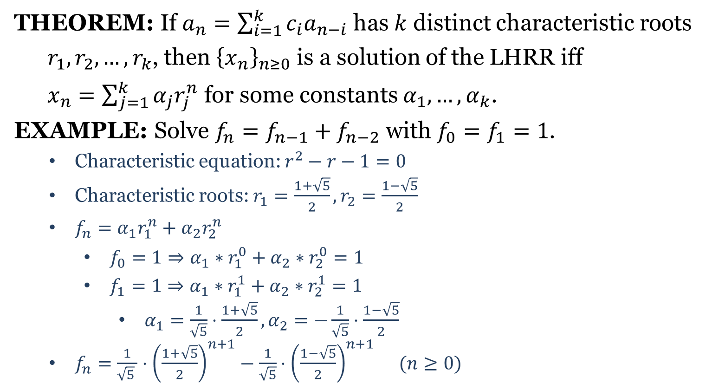
LHRR (no multiple roots)
THEOREM: If $a_{n}=\sum_{i=1}^{k}{c_{i}a_{n−i}}$ has $k$ distinct characteristic roots
$r_{1},r_{2},…,r_{k}$, then ${\left\{x_{n}\right\}}_{n≥0}$ is a solution of the LHRR iff
$x_{n}=\sum_{j=1}^{k}{α_{j}r_{j}^{n}}$ for some constants $α_{1},…,α_{k}$.
EXAMPLE: Solve $f_{n}=f_{n−1}+f_{n−2}$ with $f_{0}=f_{1}=1$.
Characteristic equation: $r^{2}−r−1=0$
Characteristic roots: $r_{1}=\frac{1+\sqrt{5}}{2},r_{2}=\frac{1−\sqrt{5}}{2}$
${f_{n}=α_{1}r_{1}^{n}+α_{2}r_{2}^{n}}_{ }$
$f_{0}=1⇒α_{1}∗r_{1}^{0}+α_{2}∗r_{2}^{0}=1$
$f_{1}=1⇒α_{1}∗r_{1}^{1}+α_{2}∗r_{2}^{1}=1$
$α_{1}=\frac{1}{\sqrt{5}}⋅\frac{1+\sqrt{5}}{2}, α_{2}=−\frac{1}{\sqrt{5}}⋅\frac{1−\sqrt{5}}{2}$
$f_{n}=\frac{1}{\sqrt{5} }⋅{\left(\frac{1+\sqrt{5}}{2}\right)}^{n+1}−\frac{1}{\sqrt{5}}⋅{\left(\frac{1−\sqrt{5}}{2}\right)}^{n+1} (n≥0)$

Slide 8
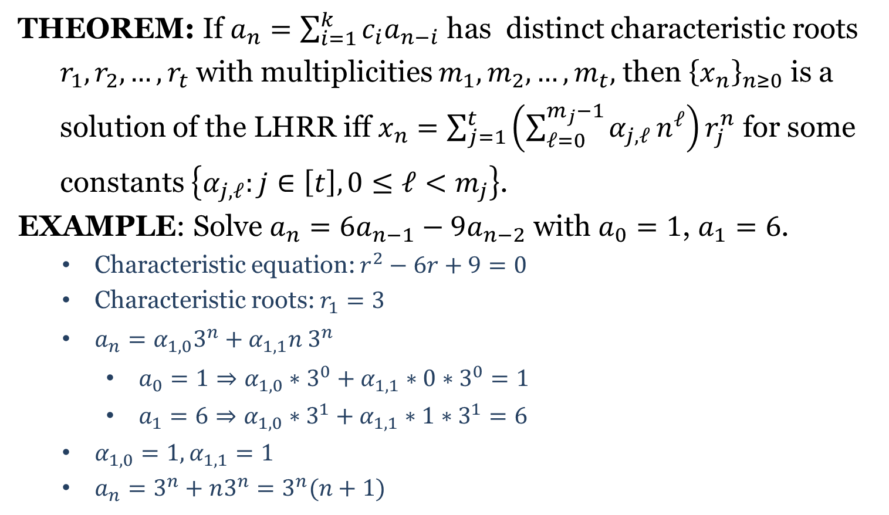
LHRR (multiple roots)
THEOREM: If $a_{n}=\sum_{i=1}^{k}{c_{i}a_{n−i}}$ has distinct characteristic roots
$r_{1},r_{2},…,r_{t}$ with multiplicities $m_{1},m_{2},…,m_{t},$ then ${\left\{x_{n}\right\}}_{n≥0}$ is a
solution of the LHRR iff $x_{n}=\sum_{j=1}^{t}{\left(\sum_{ℓ=0}^{m_{j}−1}{α_{j,ℓ}}n^{ℓ}\right)r_{j}^{n}}$ for some
constants $\left\{α_{j,ℓ}:j∈\left[t\right],0≤ℓ<m_{j}\right\}$.
EXAMPLE: Solve $a_{n}=6a_{n−1}−9a_{n−2}$ with $a_{0}=1$, $a_{1}=6$.
Characteristic equation: $r^{2}−6r+9=0$
Characteristic roots: $r_{1}=3$
${a_{n}=α_{1,0}3^{n}+α_{1,1}n 3^{n}}_{ }$
$a_{0}=1⇒α_{1,0}∗3^{0}+α_{1,1}∗0∗3^{0}=1$
$a_{1}=6⇒α_{1,0}∗3^{1}+α_{1,1}∗1∗3^{1}=6$
$α_{1,0}=1, α_{1,1}=1$
$a_{n}=3^{n}+n3^{n}=3^{n}(n+1)$

Slide 10
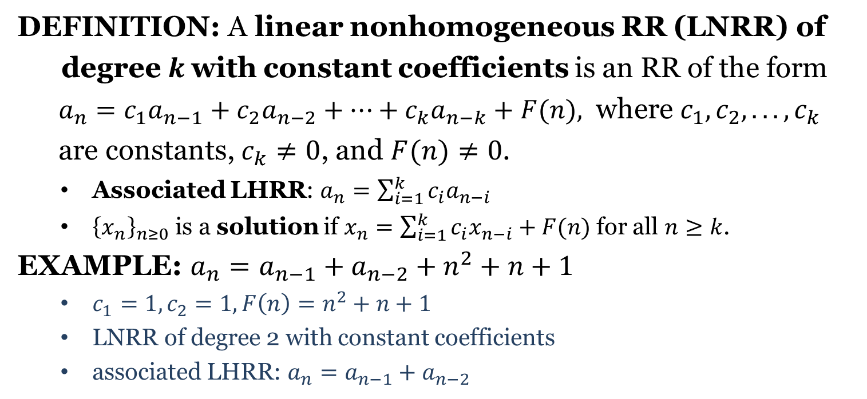
Linear Nonhomogeneous RR
DEFINITION: A linear nonhomogeneous RR (LNRR) of
degree$k$with constant coefficients is an RR of the form
$a_{n}=c_{1}a_{n−1}+c_{2}a_{n−2}+⋯+c_{k}a_{n−k}+F(n),$ where $c_{1}, c_{2}, . . . , c_{k}$
are constants, $c_{k}≠0$, and $F(n)≠0$.
Associated LHRR: $a_{n}=\sum_{i=1}^{k}{c_{i}a_{n−i}}$
${\left\{x_{n}\right\}}_{n≥0}$ is a solution if $x_{n}=\sum_{i=1}^{k}{c_{i}x_{n−i}}+F(n)$ for all $n≥k$.
EXAMPLE: $a_{n}=a_{n−1}+a_{n−2}+n^{2}+n+1$
$c_{1}=1, c_{2}=1, F\left(n\right)=n^{2}+n+1$
LNRR of degree 2 with constant coefficients
associated LHRR: $a_{n}=a_{n−1}+a_{n−2}$

Slide 11
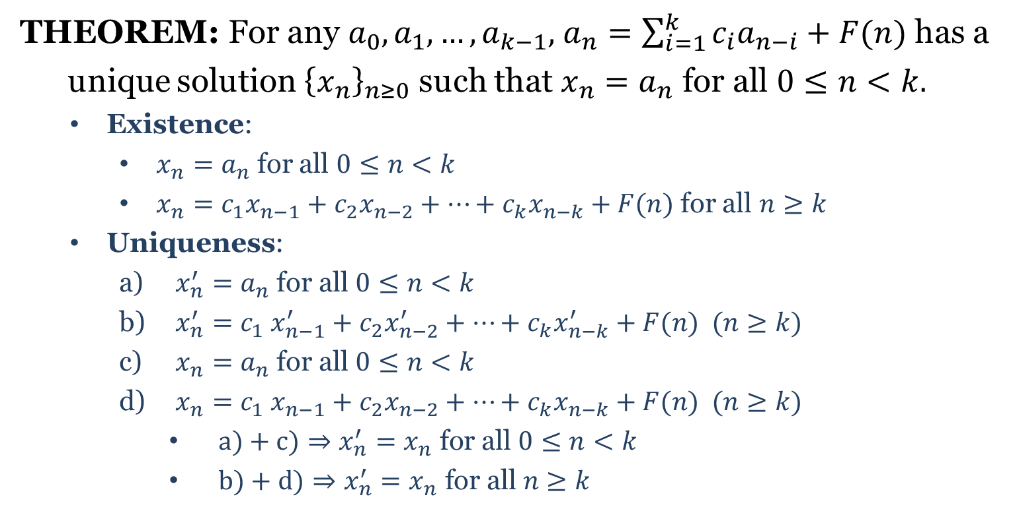
Existence and Uniqueness
THEOREM: For any $a_{0},a_{1},…,a_{k−1},$ $a_{n}=\sum_{i=1}^{k}{c_{i}a_{n−i}}+F(n)$ has a
unique solution ${\left\{x_{n}\right\}}_{n≥0}$ such that $x_{n}=a_{n}$ for all $0≤n<k.$
Existence:
$x_{n}=a_{n}$ for all $0≤n<k$
$x_{n}=c_{1}x_{n−1}+c_{2}x_{n−2}+⋯+c_{k}x_{n−k}+F(n)$ for all $n≥k$
Uniqueness:
$x_{n}^{′}=a_{n}$ for all $0≤n<k$
$x_{n}^{′}=c_{1} x_{n−1}^{′}+c_{2}x_{n−2}^{′}+⋯+c_{k}x_{n−k}^{′}+F(n) (n≥k)$
$x_{n}=a_{n}$ for all $0≤n<k$
$x_{n}=c_{1} x_{n−1}+c_{2}x_{n−2}+⋯+c_{k}x_{n−k}+F(n) (n≥k)$
$a)+c)⇒x_{n}^{′}=x_{n} \text{for} \text{all} 0≤n<k$
$b)+d)⇒x_{n}^{′}=x_{n} \text{for} \text{all} n≥k$

Slide 12
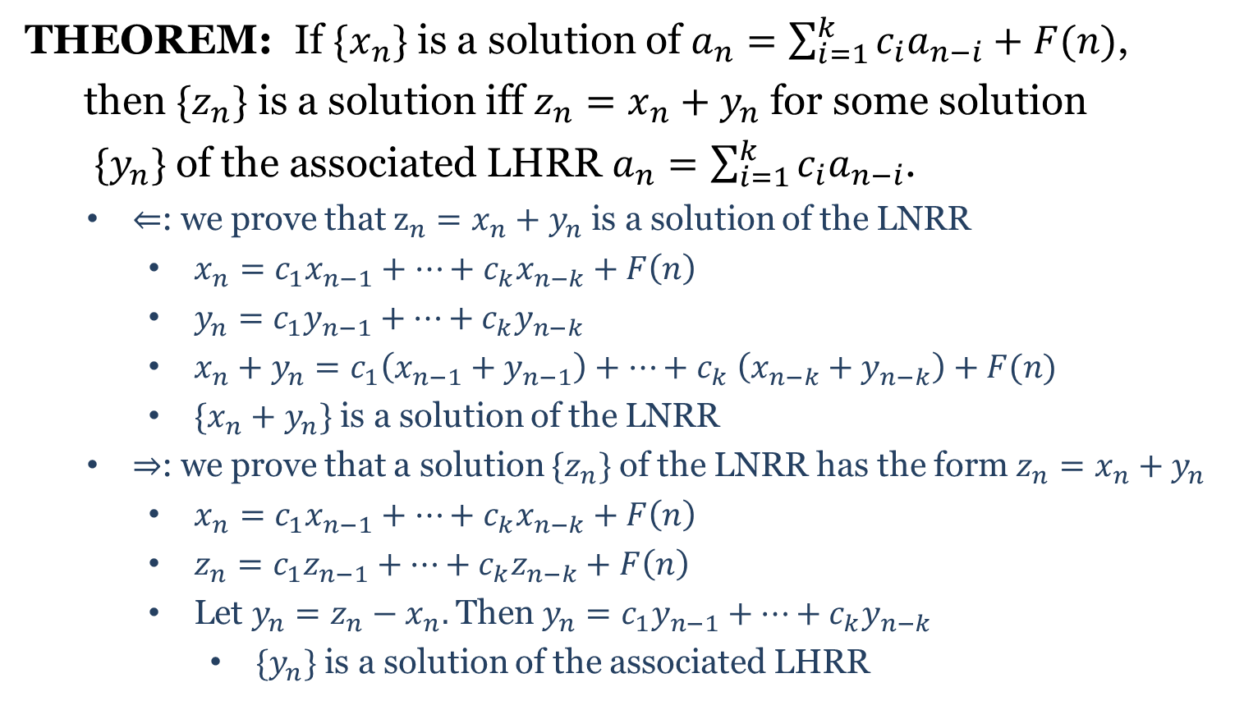
General Solutions
THEOREM: If $\{x_{n}\}$ is a solution of $a_{n}=\sum_{i=1}^{k}{c_{i}a_{n−i}}+F(n)$,
then $\{z_{n}\}$ is a solution iff $z_{n}=x_{n}+y_{n}$ for some solution
$\{y_{n}\}$ of the associated LHRR $a_{n}=\sum_{i=1}^{k}{c_{i}a_{n−i}}$.
$⇐$: we prove that $z_{n}=x_{n}+y_{n}$ is a solution of the LNRR
$x_{n}=c_{1}x_{n−1}+⋯+c_{k}x_{n−k}+F\left(n\right)$
$y_{n}=c_{1}y_{n−1}+⋯+c_{k}y_{n−k}$
$x_{n}+y_{n}=c_{1}\left(x_{n−1}+y_{n−1}\right)+⋯+c_{k} \left(x_{n−k}+y_{n−k}\right)+F(n)$
$\{x_{n}+y_{n}\}$ is a solution of the LNRR
$⇒$: we prove that a solution $\{z_{n}\}$ of the LNRR has the form $z_{n}=x_{n}+y_{n}$
$x_{n}=c_{1}x_{n−1}+⋯+c_{k}x_{n−k}+F\left(n\right)$
$z_{n}=c_{1}z_{n−1}+⋯+c_{k}z_{n−k}+F\left(n\right)$
Let $y_{n}=z_{n}−x_{n}.$ Then $y_{n}=c_{1}y_{n−1}+⋯+c_{k}y_{n−k}$
$\{y_{n}\}$ is a solution of the associated LHRR

Slide 13
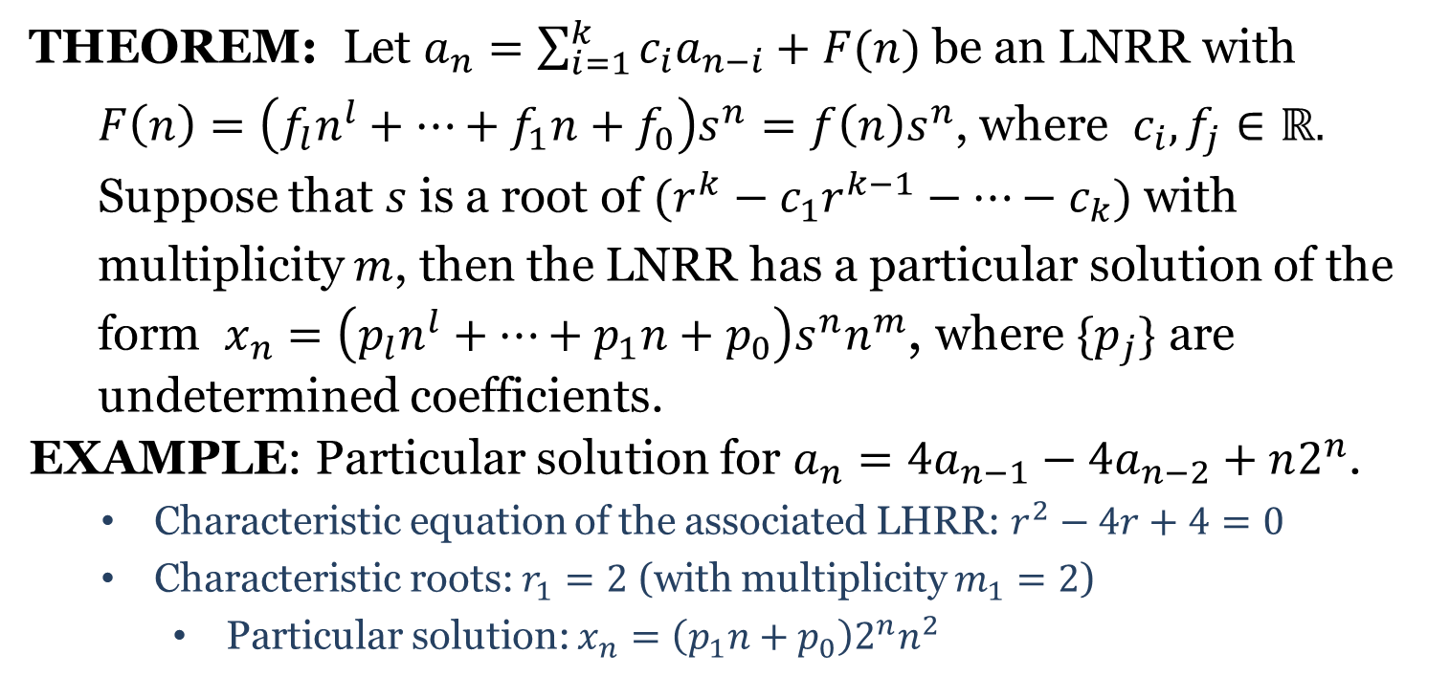
Particular Solutions
THEOREM: Let $a_{n}=\sum_{i=1}^{k}{c_{i}a_{n−i}}+F(n)$ be an LNRR with
$F\left(n\right)=\left(f_{l}n^{l}+⋯+f_{1}n+f_{0}\right)s^{n}=f\left(n\right)s^{n}$, where $c_{i},f_{j}∈ℝ.$
Suppose that $s$ is a root of $(r^{k}−c_{1}r^{k−1}−⋯−c_{k})$ with
multiplicity $m$, then the LNRR has a particular solution of the
form $x_{n}=\left(p_{l}n^{l}+⋯+p_{1}n+p_{0}\right)s^{n}n^{m}$, where $\{p_{j}\}$ are
undetermined coefficients.
EXAMPLE: Particular solution for $a_{n}=4a_{n−1}−4a_{n−2}+n2^{n}$.
Characteristic equation of the associated LHRR: $r^{2}−4r+4=0$
Characteristic roots: $r_{1}=2$ (with multiplicity $m_{1}=2$)
Particular solution: $x_{n}=\left(p_{1}n+p_{0}\right)2^{n}n^{2}$

Slide 14
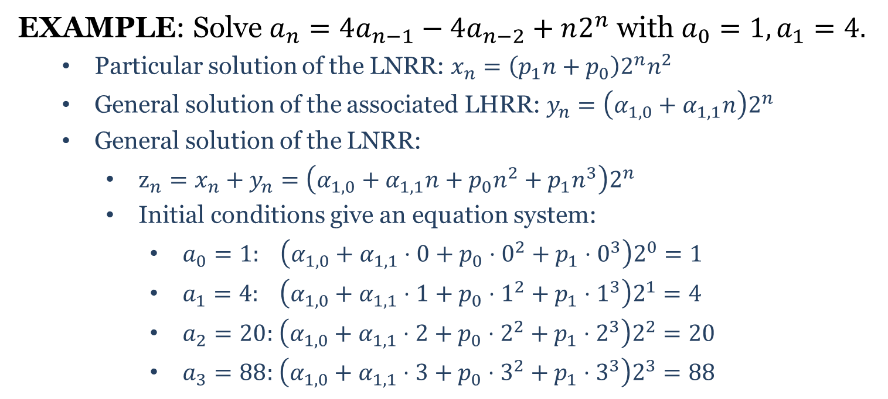
Solving LNRR
EXAMPLE: Solve $a_{n}=4a_{n−1}−4a_{n−2}+n2^{n}$ with $a_{0}=1, a_{1}=4.$
Particular solution of the LNRR: $x_{n}=\left(p_{1}n+p_{0}\right)2^{n}n^{2}$
General solution of the associated LHRR: $y_{n}=\left(α_{1,0}+α_{1,1}n\right)2^{n}$
General solution of the LNRR:
$z_{n}=x_{n}+y_{n}=\left(α_{1,0}+α_{1,1}n+p_{0}n^{2}+p_{1}n^{3}\right)2^{n}$
Initial conditions give an equation system:
$a_{0}=1: \left(α_{1,0}+α_{1,1}⋅0+p_{0}⋅0^{2}+p_{1}⋅0^{3}\right)2^{0}=1$
$a_{1}=4: \left(α_{1,0}+α_{1,1}⋅1+p_{0}⋅1^{2}+p_{1}⋅1^{3}\right)2^{1}=4$
$a_{2}=20:$ $\left(α_{1,0}+α_{1,1}⋅2+p_{0}⋅2^{2}+p_{1}⋅2^{3}\right)2^{2}=20$
$a_{3}=88:$ $\left(α_{1,0}+α_{1,1}⋅3+p_{0}⋅3^{2}+p_{1}⋅3^{3}\right)2^{3}=88$

Slide 15

The solution $\left(α_{1,0},α_{1,1},p_{0},p_{1}\right)=\left(1,\frac{1}{3},\frac{1}{2},\frac{1}{6}\right)$ gives
$a_{n}=\left(1+\frac{1}{3}n+\frac{1}{2}n^{2}+\frac{1}{6}n^{3}\right)2^{n}$

